Slide 1
Group 14 (WIP) Game Title
Alex Polley, Ryan Manthorp, Daniel Pokladek, Tom Mclaren

Slide 2
Logline/ Introduction
The history of earth is at risk when book mites that consume history invade a bookshop on the moon
Book mites eat books which subsequently destroy pieces of history, to stop this player must shoot mites before they eat books. The player must also organise books in chronological order.

Slide 3
Target Audience
Male children and teenagers
Ages 8- 16
Like puzzle games
Educational for children
Teenagers & young adults will find the historical theme interesting.
Young Adults and Teenagers will be interested in the historical and educational theme of sorting books chronologically.
In relation to the obscure sorrows, Vellichor will take our target audience back to when they were young and taking books out from book stores
Notes:
Teenagers and Kids:
historical theme of sorting books and learning history ++
Educational theme can be appealing to students and kids
Young Adults & Teenagers:
Majority of mobile players ++
They will find the theme of history interesting
Puzzle games go well with mobile games, as they are easy to play on mobile platforms

Slide 4
Emotions
Monachopsis, the subtle but persistent feeling of being out of place
Achieved by having subtle hints that this bookshop is out of place when player makes progress to the next puzzle
Vellichor, the strange wistfulness of used bookshops
Achieved by showing vintage décor and artwork of bookshop. The bookshop backgrounds will change as player progresses through puzzles.

Slide 5
What does the player do?/ Mechanics
The player will be moving books with the mouse
Player will have to stack the books in such a way that there are no gaps in order to trigger the secret doors that lead to the most important books in history
The player will also shoot mites/ worms with lasers to protect the books
Game will go from chaos to order through sorting the books

Slide 6


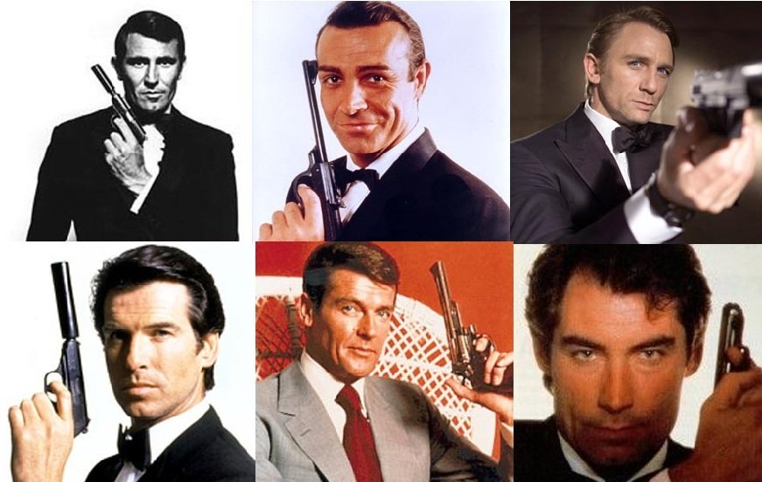
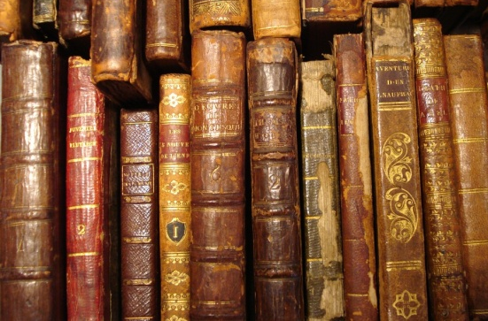
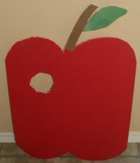
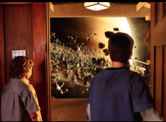
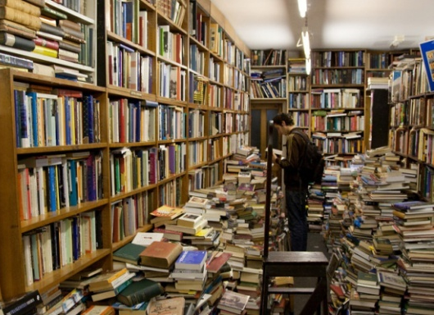
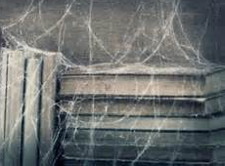
Moodboard
The burnt slow destruction of time and history
Missing countries of the world
Incorrect order
Rare & worn down books
Missing segment (eaten by worm)
Realisation you’re no longer on earth (Zathura Movie Scene)
Unorganized chaos (no order)
Dusty & ancient books

Slide 7
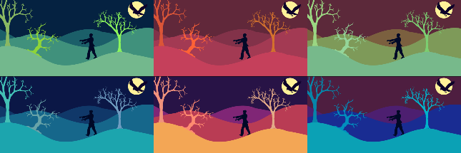

Art Style
The art style is still yet to be finalised
The Font Style chosen includes a fading effect to go in with the style of desaturated colour palette
As our backgrounds within the game change, when players progress through puzzles. Therefore our colour pallets will also represent that change.
The colour palette used will be a monochromatic palette that will slowly degrade in saturation as the player progresses through each puzzle

Slide 8
Project management
Emails sent
Alex: 7
Ryan: 5
Daniel: 2
Tom: 4
Overall: 18
Meetings
1 informal meeting, 30 mins
Hours logged
No hours logged yet, first sprint to be set today

Slide 9
Questions

